Slide 2
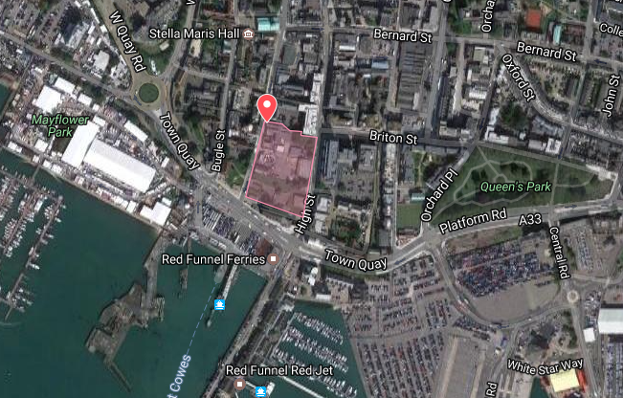

Slide 3
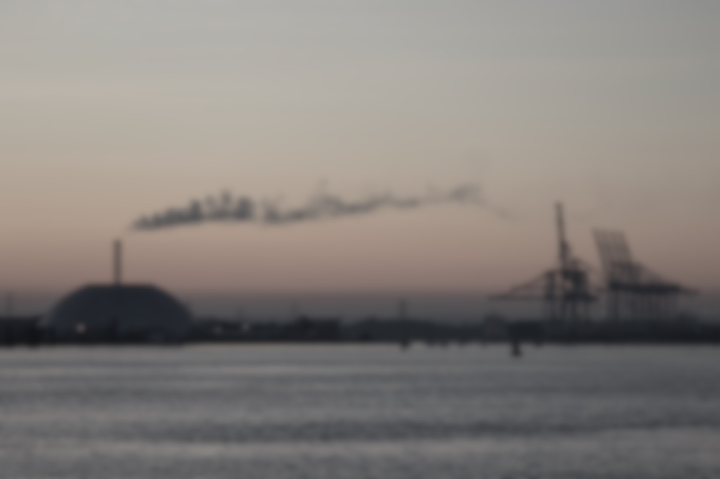
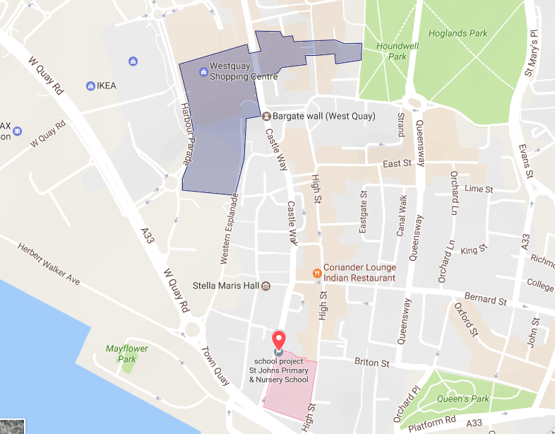
Solent Air Watch
Citizen Science Air Quality Project – West Quay
1
LIVE - AIR POLLUTION AROUND WEST QUAY
1
2
EU LAW
WHO GUIDE
2
Air quality right now is: OK
Notes:
Google map and graph is mock up
Arrow up / down

Slide 4
Solent Air Watch
Citizen Science Air Quality Project – West Quay
Air quality right now is OK
Notes:
Google map and graph is mock up
Arrow up / down

Slide 5
2
1
3
3

